Slide 1
Seminar3 – Acquiring & Storing Data
Unit 5 - Data Investigations – Case Studies
Prof. G. Williams

Slide 2
ANNOUNCEMENT
Assignment 1
DUE DATE – 8th September @ 11:55PM BST

Slide 3
Learning outcomes
Identify and manage challenges, security issues and risks, limitations, and opportunities in data wrangling.
Critically analyse data wrangling problems and determine appropriate methodologies, tools, and techniques (involving preparing, cleaning, exploring, creating, optimising and evaluating big data) to solve them.
Design, develop and evaluate solutions for processing datasets and solving complex problems in various environments using relevant programming paradigms

Slide 4
Acquiring and Storing Data
Sources of Data(Government, International Agencies, Research Institutions, Open Data, EU, IMF, Open Nepal, Open Data Hong Kong, WHO reports – Ebola Crisis )
Fact Checked (Verifiable, Searches, Cross Referencing, Contacting Original source)
Readability (XML, JSON, CSV, SQL - Relational )
Cleanliness (Eliminating Duplication, Redundancies, Human Error)
Longevity (How long can data be kept)

Slide 5
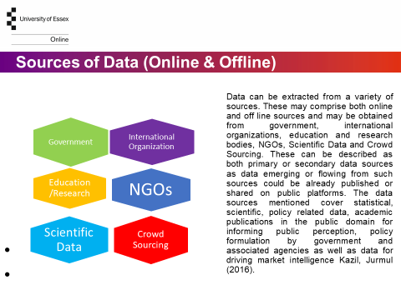

Slide 6
FACT FINDING & CHECKING
Data Source verifiable
Frequency of Data update & error check
Test Data
Plausibility & Logicality
Talk to an expert
Methods for Data Acquisition
Data Validation
No duplications & Redundancies
Using Subscriber only published Archives
Fact finding is the process of employing investigative methods to extract data from a variety of data storage sources. Checking of the facts extracted from the data sources is an essential and critical aspect of the quality process. This involves verification, thus ensuring the sources can be trusted, validation which is ensuring the data is what is meant to be. In other words it constitutes the integrity of the data obtained. Part of this quality process could also involve ensuring that there is validation of the data by checking the frequency of data source. This may also involve talking to an expert to verify the facts or validate the integrity of the data Kazil, Jurmul (2016). Facts could be verified using access tools like LexisNexis, the congressional quarterly library, google scholar search, JSTOR and Cornel University’s arXiv project.

Slide 7
Readability, Cleanliness & Longevity
Readability, Cleanliness and Longevity form part of the quality process in handling data. Key routines and tasks involve carrying out updates, reporting errors or any form of misreporting. Methods used in performing any tasks should be verifiable or validated. With respect to longevity. it is essential to evaluate the adaptability, portability and interoperability of the data in the system. Readability, cleanliness and longevity are highly dependent on the sources of data and who generated, processed and stored the data Kazil, Jurmul (2016).
Readability
Updates
Errors or Misreported
Methods
Cleanliness
How clean is your data?
Longevity
Adaptable
Portable
Interoperable

Slide 8
CLOUD STORAGE
Hierarchical Data Format(HDF)
HADOOP
IBM Watson
Clouds are distributed databases deployed remotely that stores big data in a variety of formats. This could be accessible by users regardless of location, business function, routine or operation. Hierarchical data format(HDF) is a file format organized in a structure that enables the storage of large data sets in a tree like structure. IBM Watson provides a cloud framework for data accessibility as well as modelling functions designed to enable the management of big data Ohlhorst (2012).
.

Slide 9
ESSENTIAL PROGRAMMING COMPONENTS & CONCEPTS
WEB SCRAPING - The process of collecting and parsing raw data from a website.
PARSING/PARSER – A Parser analyses a string of text using a lexical Analyzer to determine whether the text conforms with the grammatical or syntax structure of the source language.
PARSER TREE – This is created by the parser to ensure that the text or string of data being transmitted is orgainzed
WEB PAGE (CLIENT) – This is the calling or request program
API - Application Programming Interface - This enables inter process communication comprising functions such as parsing, concurrent, multi processing, data communication and interconnectivity. Examples are BeautifulSoup, DSM(Device Support Module), REST API (Twitter), SOAP (Simple Object Access Protocol)
MIDDLEWARE – The Framework and Application resource that enables a variety of programming tools to interconnect and serve as a bridge between an operating system and an application. It could also be between a database and an application.
DATA STORAGE - Storage files such as SQL, JSON and XML
IDE – Integrated Development Environment – Serves as a single point for writing programming applications. Applications that facilitates the development of other applications CODIO, JUPITER NOTES, COLAB etc.
Source: IBM 2022

Slide 10
Acquiring data using data scraping/Python – Key steps
GOTO:
Command prompt
AT COMMAND prompt type Python
Install the following modules/libraries – bs4, requests & html5lib using “pip” command.
From bs4 import BeautifulSoup
Import requests
Import html5lib
URL= “https://www.who.int/publications/item/optimized-supportive-care-for-ebola-virus-disease”
r = requests.get(URL)
print (r.content)

